Slide 1
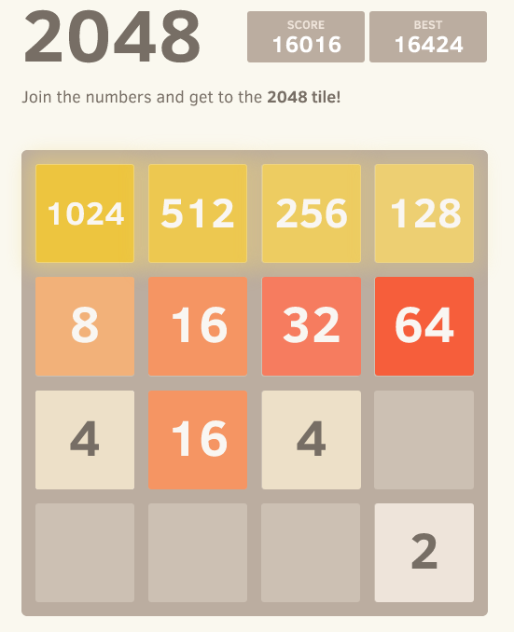
Introduction to 2048
Learn about the addictive puzzle game 2048. Discover how it works, its uses, advantages and disadvantages, and its future scope.

Slide 2
How Does 2048 Work?
Merge and Match
Combine tiles with the same number to create a new tile with a higher value.
Swipe to Move
Use swipe gestures to move tiles in different directions on the game board.
Strategy is Key
Plan your moves carefully to maximize the score and reach the elusive 2048 tile.
Endless Challenge
Continue playing even after reaching 2048 to achieve higher scores and challenge your skills.

Slide 3



How is 2048 Used?
On Mobile Devices
In Educational Settings
In Team Building
The game is popularly played on smartphones and tablets, providing an entertaining way to pass the time.
Teachers and students use 2048 to exercise their problem-solving and critical thinking skills.
2048 can be used as a team building activity to foster collaboration and communication among colleagues.

Slide 4
Advantages & Disadvantages
Advantages
Disadvantages
Brain Exercise: 2048 is a puzzle game that stimulates your brain. It requires logical thinking and strategic planning to combine tiles and reach higher values.
Improves Cognitive Skills: Playing 2048 can enhance problem-solving, critical thinking, and logical reasoning abilities.
Community and Strategy Sharing: 2048 has built a community of players who share strategies and tips. This fosters a sense of camaraderie among players looking to improve their skills.
Addictive Gameplay: The addictive nature of 2048 keeps players engaged and entertained for hours.
Time-Consuming: Engaging in 2048 for long periods can be time-consuming and distract users from other activities.
Potential for Frustration: Difficult gameplay challenges can lead to frustration and discourage some players from continuing.

Slide 5
The Future of 2048
1
Enhanced Graphics & Features
Future versions of 2048 may offer improved visuals and additional gameplay features.
2
Integration with Virtual Reality
Imagine immersing yourself in the world of 2048 with virtual reality technology.
3
Multiplayer Capabilities
Possibility of playing 2048 against friends or other online opponents to add a competitive dimension.

Slide 6
Conclusion
A Game of Strategy 2048 is not just a simple puzzle game, but a challenging test of strategic thinking.
Endless Entertainment: With its addictive nature and potential for high scores, 2048 offers endless hours of entertainment
The Evolution Continues: Exciting developments and new features await in the future of 2048.

